Slide 1



Addressing Mental Health Challenges in the Tech Industry
Alec Collins Donald Doggett | Ilsa Naumani Marc Arft

Slide 2
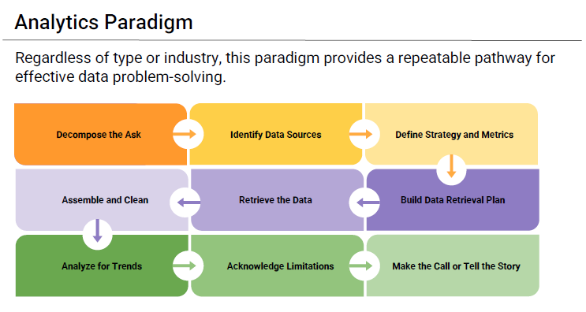

Slide 3
Decompose the Ask?
Question 1: How does constant technology exposure affect tech employees' mental well-being, considering workplace culture, treatment accessibility, and remote work dynamics?
First: Identify the independent variables
Anonymity Care Options Coworkers Family History Mental Health Benefits Mental Health Stigma | Number of Employees Physical Health Stigma Resources Available Supervisor Tech Company Treatment Wellness Programs
Notes:
To break down the research question into measurable components, we need to identify the independent variables (factors being measured or manipulated). Iindependent variables are those that can influence or predict outcomes related to mental health among tech employees.

Slide 4

EXPLORATION: Identify Data Sources
Dataset: Mental Health in Tech Survey
https://www.kaggle.com/datasets/osmi/mental-health-in-tech-survey
Dataset from a 2014 survey on mental health in the tech workplace.
Focuses on attitudes towards mental health and frequency of mental health disorders.
Covers employee demographics (age, gender, occupation) and company characteristics (size, industry, location).
Examines the prevalence of mental health conditions among tech employees.
Explores workplace mental health support and resources offered by companies.
Highlights comfort levels in discussing mental health with supervisors or colleagues.
Encourages comparison with data from the ongoing 2016 survey.
Aims to identify trends in mental health awareness within the tech industry.
Notes:
This dataset comes from a 2014 survey conducted to explore attitudes towards mental health and the prevalence of mental health disorders within the tech industry. The survey aimed to better understand how employees in tech workplaces view mental health issues, whether they feel comfortable discussing mental health at work, and how mental health support is perceived in their work environments.
Key aspects of the dataset include:
Demographics: Age, gender, and occupation of respondents.
Workplace characteristics: Size of the company, industry type, and geographic location.
Mental health status: Information on whether the respondents have been diagnosed with a mental health disorder, and the prevalence of such conditions.
Workplace mental health support: Insights into whether companies offer mental health resources, and how comfortable employees are discussing mental health issues with supervisors.

Slide 5
Define Strategies and Metrics
Define Strategy/ Metrics to Collect: AgeGender Country State self_employed family_history remote_work tech_company no_employees Benefits care_options | wellness_program seek_help Anonymity Leave mental_health_consequence phys_health_consequence Coworkers Supervisor mental_vs_physical obs_consequence

Slide 6
TELLING THE STORY: Build a Data Retrieval Plan
Filter Responses by Tech Employees
Analyze the Impact of Mental Health on Work Performance
Examine the Rate of Mental Health Treatment
Evaluate the Availability of Mental Health Resources
Investigate Stigmatization and Consequences
Compare Willingness to Discuss Mental Health with Supervisors and Coworkers
Impact of Isolation on Remote Workers
Notes:
Impact of Mental Health on Work Performance: Analyze "work_interfere" responses to see if tech employees report more work interference due to mental health compared to other sectors.
Rate of Mental Health Treatment: Examine the "treatment" responses. Higher treatment-seeking rates in tech employees may indicate greater mental health issues related to technology exposure. Availability of Mental Health Resources: Assess responses to "benefits," "care_options," and "wellness_program" questions. If tech employees report fewer resources despite high stress, it suggests a gap in support.
Mental Health vs. Physical Health Perception: Evaluate "mental_vs_physical" responses. Lower scores among tech employees could indicate that mental health is not prioritized like physical health.
Stigmatization and Consequences: Review "mental_health_consequence" and "obs_consequence" responses. A belief among tech employees that discussing mental health may lead to negative outcomes could point to a toxic work environment.
Willingness to Discuss Mental Health: Analyze "coworkers" and "supervisor" responses. Lower willingness among tech employees to discuss mental health may reflect a culture of isolation exacerbated by remote work and high demands.
Impact of Remote Work: Investigate "remote_work" responses. Correlate remote work with mental health challenges like treatment-seeking and willingness to discuss issues, highlighting potential effects of isolation and constant tech engagement.

Slide 7

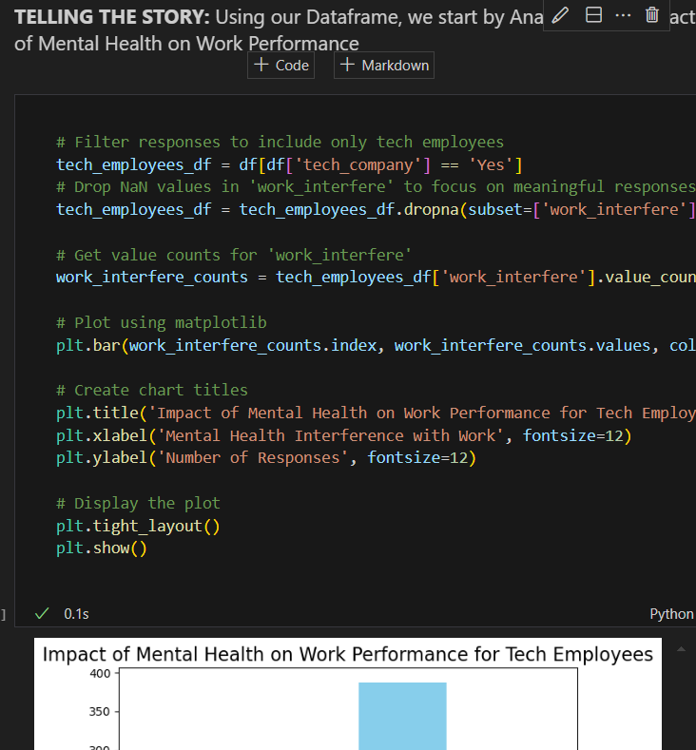
See Notebook

Slide 8
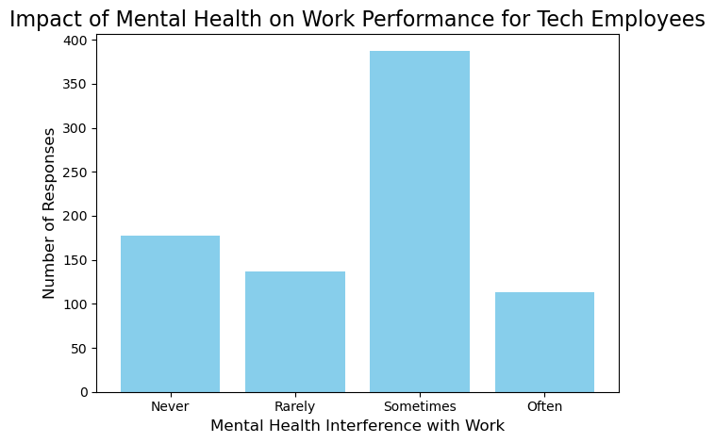
Analyze the Impact of Mental Health on Work Performance
This graph tells us that "Sometimes" is the most common frequency of mental health interference, with approximately 350-400 employees reporting this
This suggests that mental health occasionally impacts work performance for a significant portion of tech employees.

Slide 9
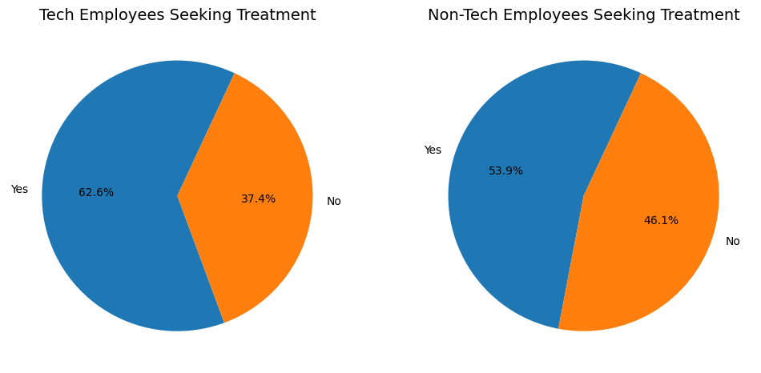
Examine the Rate of Mental Health Treatment
This chart shows that 62.6% of tech employees have sought treatment for mental health issues vs. 53.9 in non-technical roles.
The data suggests that a significant portion of tech employees are aware of the mental health challenges they face, possibly exacerbated by constant technology exposure, and more seek treatment to address these issues than do non-tech employees.

Slide 10
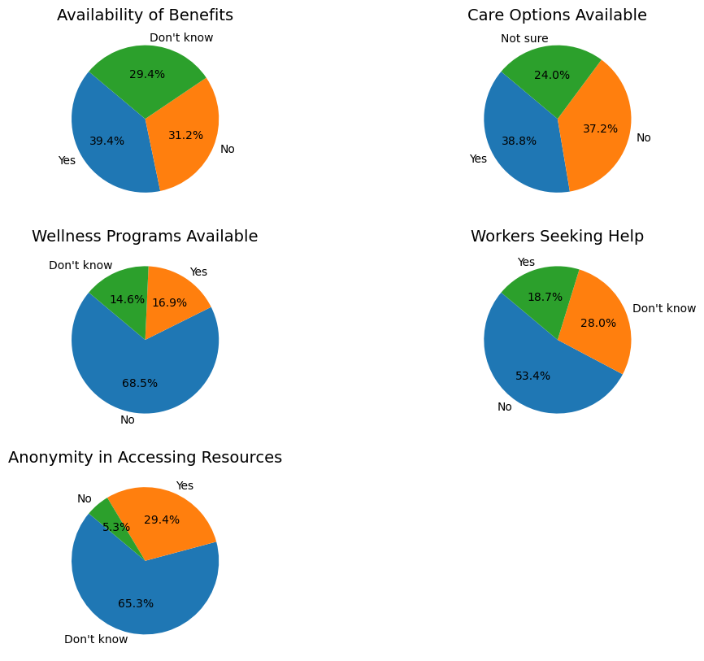
Evaluate the Availability of Mental Health Resources
If mental health resources are widely available and effectively utilized, tech employees may be better equipped to handle stress, anxiety, or burnout. This support can directly reduce the negative impact of mental health issues on their productivity, focus, and overall job performance.
According to these statistics, many workers do not have or do not know about mental health resources.

Slide 11
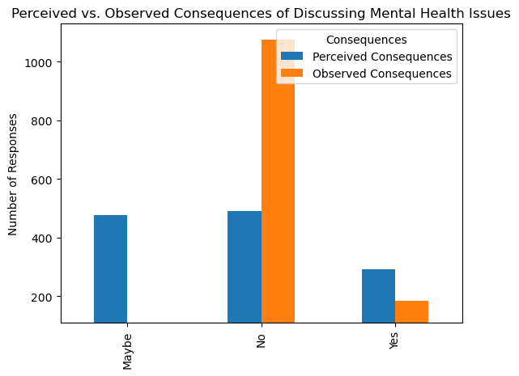
Investigate Stigmatization and Consequences
Analyzing concerns about discussing mental health issues in the workplace highlights the impact of constant technology exposure on tech employees' mental well-being. The data shows that perceived consequences of discussing mental health are significantly higher than actual observed consequences, indicating a disconnect between employee fears and the realities faced by their coworkers. This gap underscores existing stigma and support structures within workplace culture and suggests that technology may exacerbate feelings of isolation and pressure. Furthermore, observed consequences for coworkers with mental health conditions reveal potential negative patterns in workplace dynamics, especially in remote work settings.

Slide 12
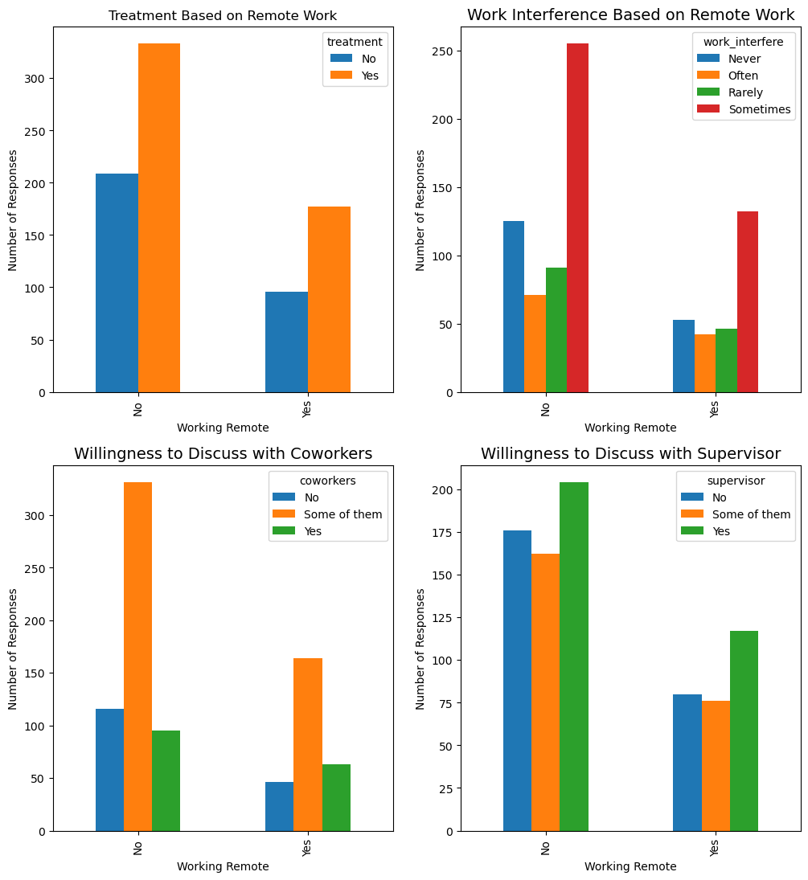
Compare Willingness to Discuss Mental Health with Supervisors and Coworkers
Evaluating the concerns related to discussing mental health issues in the workplace provides crucial insights into the impact of constant technology exposure on tech employees' mental well-being. By examining the perceived consequences of discussing mental health, one can identify existing stigma and support within the workplace culture, highlighting how technology may exacerbate feelings of isolation and pressure. Observed consequences for coworkers with mental health conditions reveal potential negative outcomes and patterns that reflect workplace dynamics, especially in remote work settings.

Slide 13
The End

